Slide 1
The First Team Meeting
Dirk Riehle, FAU Erlangen
COACH A03
Licensed under CC BY 4.0 International

Slide 2
Set-up
Create Zoom link for team meeting
Communicate Zoom link in advance
Communicate Zoom link right before meeting to catch late additions
Please watch out for bouncing email addresses and let me know

Slide 3
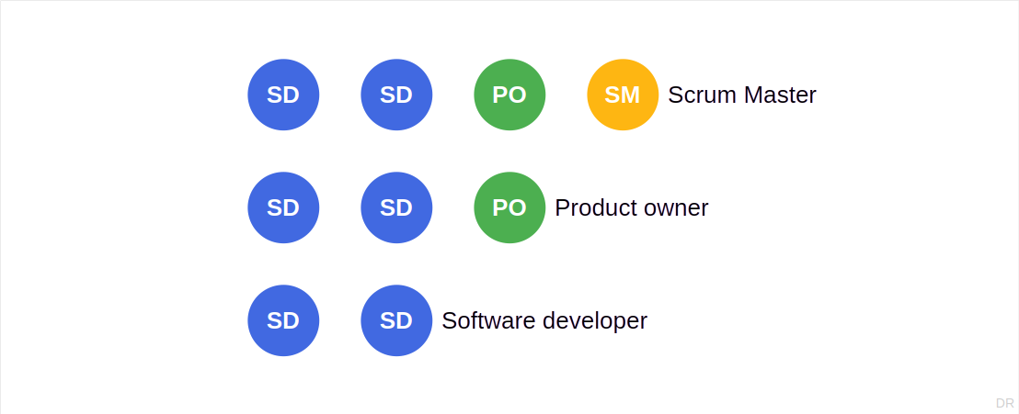
Team Structure

Slide 4
First Meeting
Check participation
No-shows (without explanation) will be removed

Slide 5
Team Issues
Your team’s success
Steady participation wins the course
Team size does not matter
Credit points (ECTS) determine time spent

Slide 6
Student Abuse
Do not act as a relay for student requests
Students should ask us directly if they want something
You can tell them that I don’t take it lightly if they play games

Slide 7
Thank you! Any questions?
dirk.riehle@fau.de – https://oss.cs.fau.de
dirk@riehle.org – https://dirkriehle.com – @dirkriehle

Slide 8
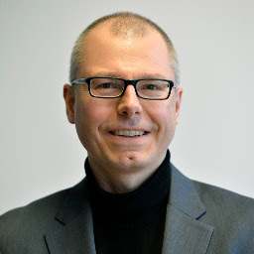
Thank You! Any Questions?
Prof. Dr. Dirk Riehle, M.B.A.
dirk.riehle@fau.de, https://oss.cs.fau.de
dirk.riehle@bayave.com, https://bayave.com
dirk@riehle.org, https://dirkriehle.com
Twitter: @dirkriehle

Slide 9
Legal Notices
License
Licensed under the CC BY 4.0 International license
Copyright
© Copyright 2022 Dirk Riehle, some rights reserved

